Slide 1
4:- Implement the Logistic Regression algorithm on the Breast Cancer dataset and evaluate if the model is good for deployment.

Slide 2
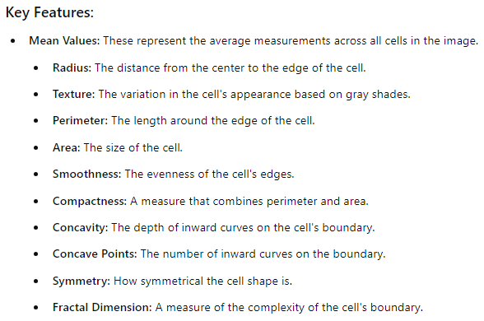
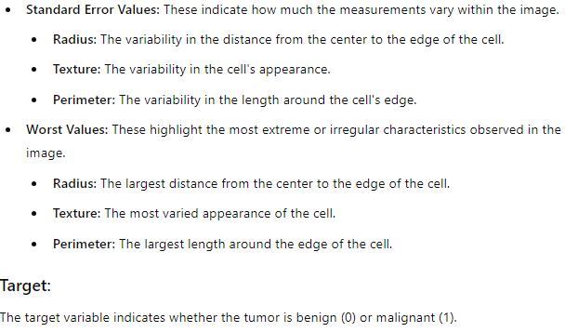
Dataset:-
The dataset consists of various features that describe the characteristics of cell nuclei in breast tumor samples. Each feature helps in identifying whether a tumor is benign (non-cancerous) or malignant (cancerous).

Slide 3
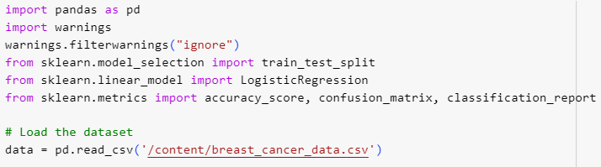
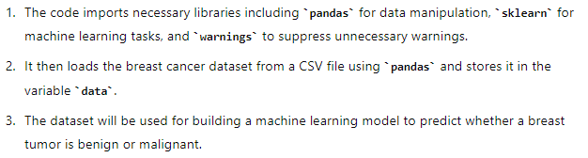
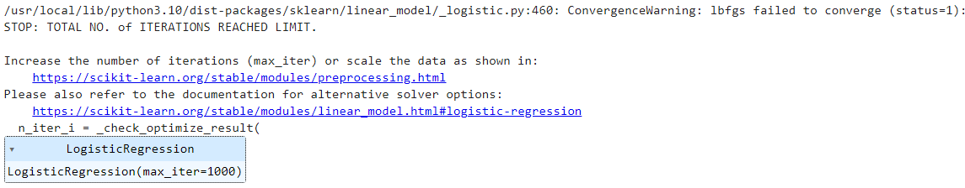

Without Warning:
With Warning:
To handle the ConvergenceWarning or any other type of warning and keep your output clean, it's a good practice to import the warnings module and suppress such warnings. This prevents the output from looking messy, especially if the warning occurs due to a glitch or other factors that don't affect the overall performance of your model.

Slide 4
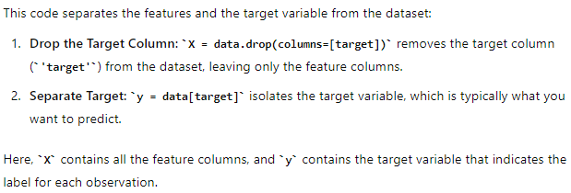

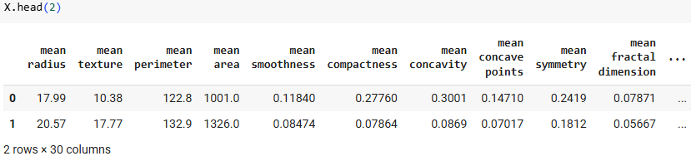
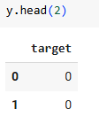

Slide 5
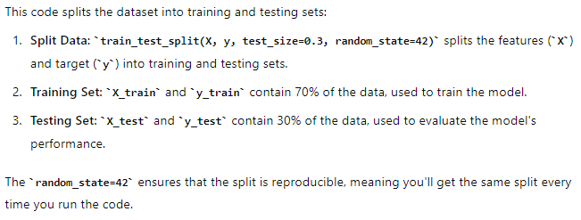
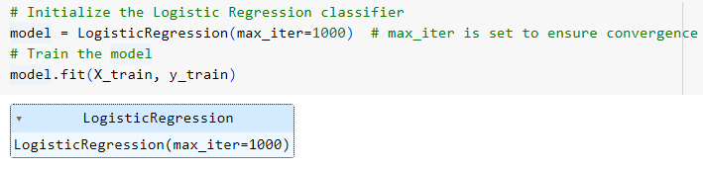
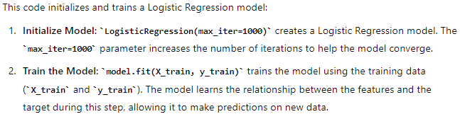

Slide 6
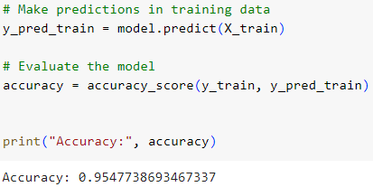
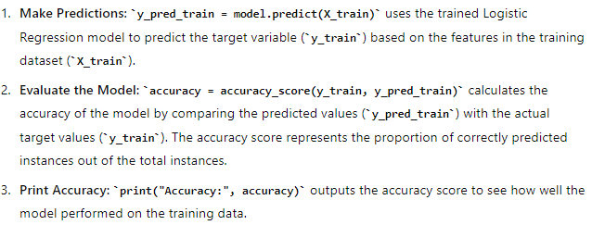
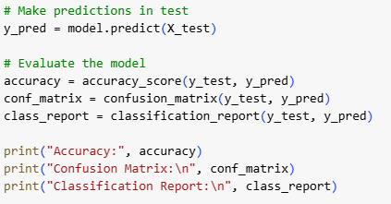
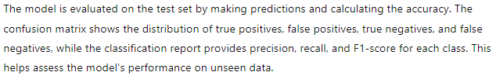

Slide 7
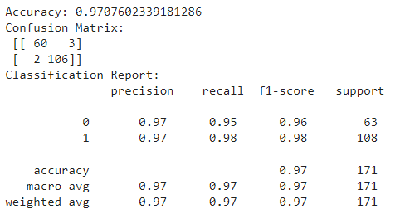
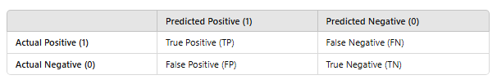
The model achieved an accuracy of 97%, meaning it correctly classified 97% of the test samples. The confusion matrix shows that the model correctly identified 60 benign (0) and 106 malignant (1) cases while misclassifying 3 benign as malignant and 2 malignant as benign. The classification report indicates high precision, recall, and F1-scores for both classes, with the malignant class (1) showing slightly better performance. Overall, the model demonstrates strong performance, particularly in identifying malignant cases.

